Slide 1


K.RAMAKRISHNAN COLLEGE OF TECHNOLOGY
(AUTONOMOUS), TRICHY.
DEPARTMENT OF
COMPUTER SCIENCE AND ENGINEERING
20CS5501 DESIGN PROJECT-1
Batch No. : 16
Date : 06.12.2024

Slide 2
INTERACTIVE JOB INTERVIEW
PREPERATION
Guided by Team
Mrs.K.VALLI PRIYADHARSHINI.Ph.d MUHUNDAN S(811722104095)
Assistant Professor, CSE PRITHICK ROSHAN S
(811722104113) RAJESH R (811722104117)

Slide 3
OBJECTIVE OF THE PROJECT
Practicing Interview Questions: Anticipating commonly asked interview questions, such as those about strengths, weaknesses, past experiences, and behavioral situations , and preparing structured, concise, and impactful responses.
Refining Communication Skills: Enhancing my verbal and non-verbal communication, including tone, clarity, and body language, to ensure that I present myself with confidence, professionalism, and enthusiasm during the interview.
Developing Questions for the Interviewer: Formulating insightful and thoughtful questions about the company, team dynamics, or job role to show my genuine interest in the position and the organization.
Reviewing Technical Skills and Knowledge: If applicable, preparing for any technical assessments or skill-based evaluations that might be part of the interview process, and ensuring I am up-to-date on industry trends or tools relevant to the role.

Slide 4
ABSTRACT
An interview job preparation website serves as a comprehensive platform designed to equip job seekers with essential tools and strategies for success. It offers tailored resources, including resume and cover letter templates, common interview questions, and expert guidance on crafting impactful responses. Users can access interactive mock interviews, tips on mastering body language, and advice on handling different interview formats such as virtual, technical, and behavioral. The platform also features industry-specific insights, scheduling tools, and personalized feedback to boost confidence and readiness. By integrating practical exercises with expert advice, the website empowers users to showcase their strengths and secure their desired roles.

Slide 5
LITERATURE SURVEY
TITLE OF THE PAPER | AUTHOR (S) | PUBLISHER | PAPER GIST | TECHNOLOGY USED
AI-Driven Mock Interviews for Job Preparation | Various | IJRASET. | This paper discusses AI-based mock interview platforms using technologies like deep learning, natural language processing (NLP), and emotion recognition to provide real-time feedback | Convolutional Neural Networks (CNN), Python (Pydub, spaCy), and semantic analysis tools.
Effective Interview Design in Research | Hamed Taherdoost | International Journal of Academic Research in Management | This paper focuses on designing effective interview protocols, considering ethical issues, question formulation, and the importance HAL iew planning. The emphasis is on clarity and relevance in question design | Qualitative analysis frameworks.
Digital Platforms for Job Skill Enhancement | Multiple contributors | SpringerLink | The study examines digital learning platforms that enhance job see​IJRASET ills. It highlights personalized learning paths and AI-driven modules for self-assessment. | Machine learning algorithms, e-learning platforms.

Slide 6
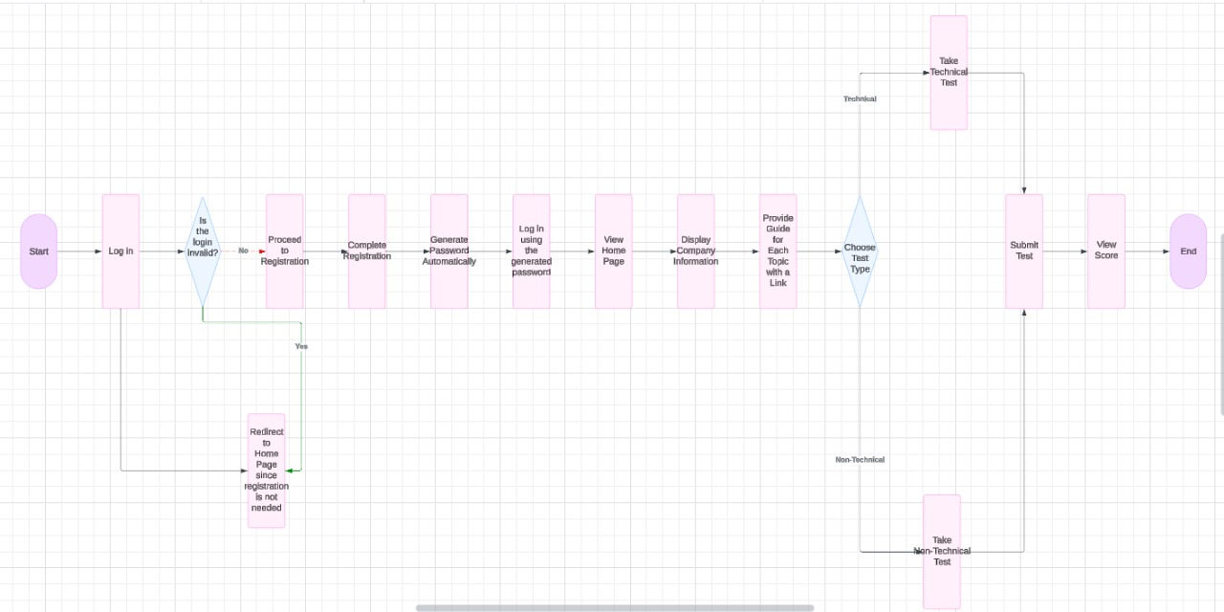
PROPOSED SYSTEM ARCHITECTURE

Slide 7
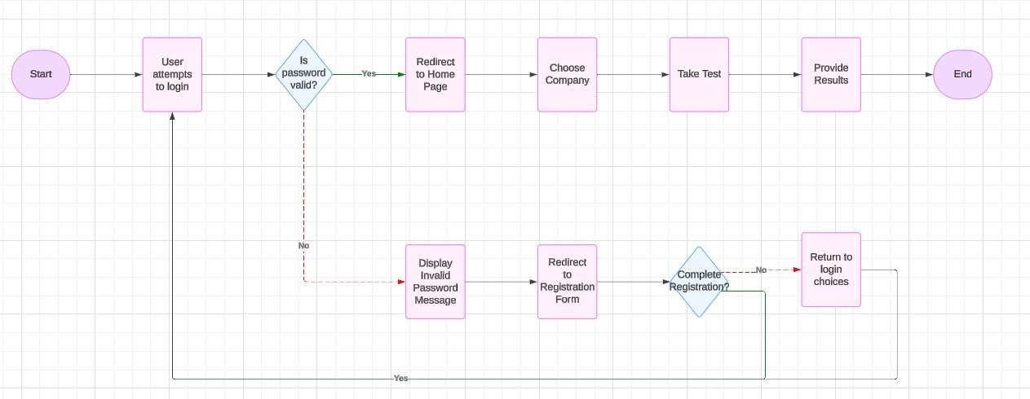
EXISTING SYSTEM ARCHITECTURE

Slide 8
SOFTWARE AND HARDWARE REQUIREMENTS
HARDWARE
SOFTWARE
Processor:
Quad-Core (Intel i7 )
RAM:8 GB
Storage: Minimum: 128 GB SSD or HDDspace for development and testing environments
Operating System: Windows10/11
Code Editor:
Visual Studio Code (VS Code).
Web Browsers:
Google,Firefox, Edge, or Safari for cross-browser testing.
Live Server Extension:
Use the Live Server extension in VS Code to preview HTML/CSS/JavaScript changes in real-time.

Slide 9
MODULES
User Module
Content Management Module
Question Bank Module
Mock Interview Module
Feedback & Analytics Module

Slide 10
SUMMARY OF MODULE-1
USER MODULE:-
To manage user accounts and provide a personalized, secure platform for job seekers to access and track their interview preparation resources.
Purpose: Allow users to create an account and manage their profile.
Essential Features:User registration and login. Profile management (name, contact info, etc.).
Reasoning: Users need secure access and the ability to manage their personal details.

Slide 11
SUMMARY OF MODULE-2
CONTENT MANAGEMENT SYSTEM:-
Purpose:-
To efficiently organize, manage, and deliver dynamic content tailored to the needs of users, ensuring up-to-date and relevant interview preparation materials.
Essential Features:-
Categorizes materials for easy navigation and quick access to relevant resources. Supports videos, quizzes, and interactive content for a richer user experience.
Reasoning:-
These features ensure that the platform remains efficient, secure, and relevant, providing users with high-quality, easily accessible content throughout their preparation journey

Slide 12
SUMMARY OF MODULE-3
QUESTION BANK MODULE :-
Purpose: To provide a comprehensive repository of interview questions tailored to various roles and industries, enhancing users’ preparation.
Efficient Features:-
Categorizes materials (e.g., articles, videos, templates), making it easy for users to find relevant resources quickly. Offers model responses to guide users in structuring their answers effectively
Reasoning:-
These features ensure a structured, adaptive approach to interview preparation, allowing users to build confidence and readiness.

Slide 13
SUMMARY OF MODULE-4
MOCK INTERVIEW MODULE:-
Purpose: To simulate real interview scenarios, allowing users to practice and improve their performance through realistic experiences and feedback.
Essential Features:-
Offers interview simulations tailored to specific jobs, helping users prepare for industry-relevant questions. Monitors performance across multiple sessions, helping users gauge improvement over time.
Reasoning:-
These features offer an immersive and personalized interview practice experience, boosting confidence and readiness for real-world scenarios

Slide 14
SUMMARY OF MODULE-5
FEEDBACK & ANALYTICS MODULE:-
Purpose: To provide users with actionable insights based on their performance, helping them identify strengths and areas for improvement.
Essential Features:-
Provides iterative feedback after each session, encouraging users to refine their skills consistently.
Reasoning:-
This module ensures a data-driven approach to learning, empowering users to make informed decisions about their interview preparation journey.

Slide 15
RESULTS AND DISCUSSION
The development of an interview job preparation webpage yielded several valuable insights. User-centered modules, such as a resume builder, interactive mock interviews, and personalized question banks, were shown to significantly enhance preparation outcomes. Research highlights the importance of structured interviews. Additionally, AI-driven tools like real-time feedback systems and emotion analysis were found to improve users' communication and confidence【17†source】.
The integration of company-specific insights and industry trends ensures that candidates are well-prepared for both technical and behavioral questions. Discussion also emphasized the role of feedback loops and practice sessions in boosting performance, as continuous improvement models help users refine their strategies effectively. These findings underscore the potential of digital platforms to empower job seekers, offering holistic and data-driven support tailored to individual needs.

Slide 16
CONCLUSION
An interview job preparation webpage serves as a crucial tool for job seekers, offering comprehensive resources and guidance to improve their chances of success.
By integrating modules such as resume builders, mock interview practice, question banks, and company research tools, the platform can cater to diverse user needs.
Emphasizing structured interview techniques, personalized feedback, and AI-driven mock scenarios ensures users can refine their skills effectively.
Ultimately, the combination of technology and expert insights empowers candidates to approach interviews with confidence, improving their ability to present themselves professionally and secure desired job opportunities.

Slide 17
THANK YOU

